Slide 1

MLSA INTERNSHIP PPT
BY: 2300290120119_KHUSHI_CS_3B

Slide 2
CONTENT
1.TODO APP
2.WEATHER API

Slide 3
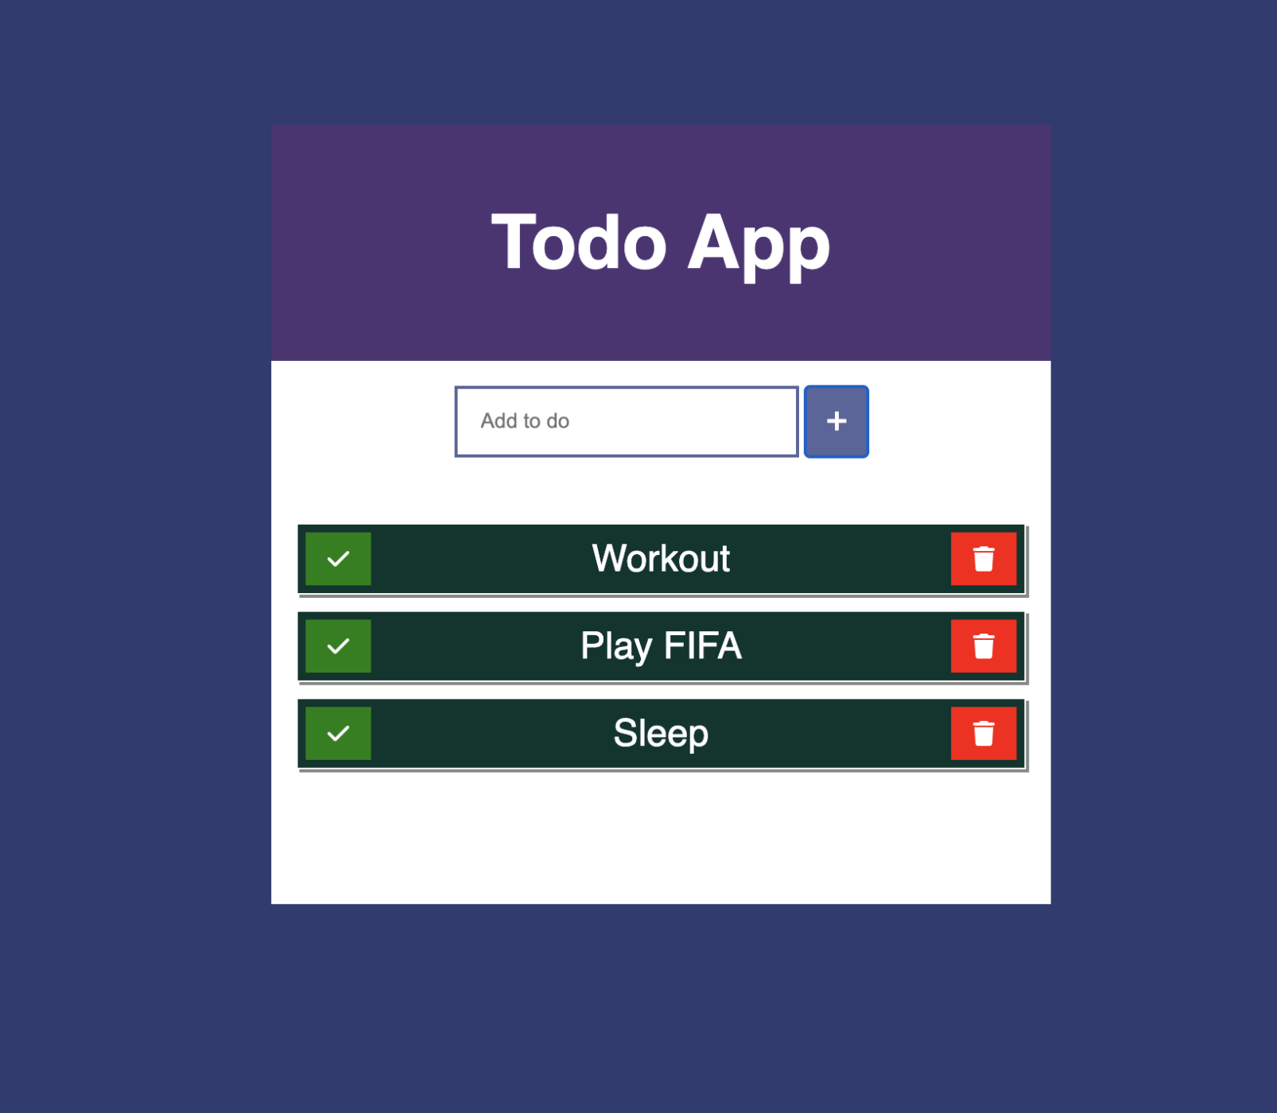
TODO APP:
Our intuitive to-do list app helps you manage all of your tasks to meet project deadlines. It is built using HTML and JavaScript.

Slide 4

WEATHER API
It acts as an intermediary, enabling software applications to access real-time, forecasted, and historical weather information. These APIs pull data from numerous meteorological stations, satellites, radars, and other weather data sources, providing comprehensive weather details in a structured and easily accessible format.
Weather API is built using JavaScript Functions and React

Slide 5

Thank You

